Slide 1
Development of
Convolutional
Neural
Network

Slide 2
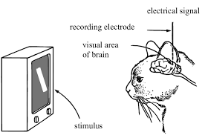
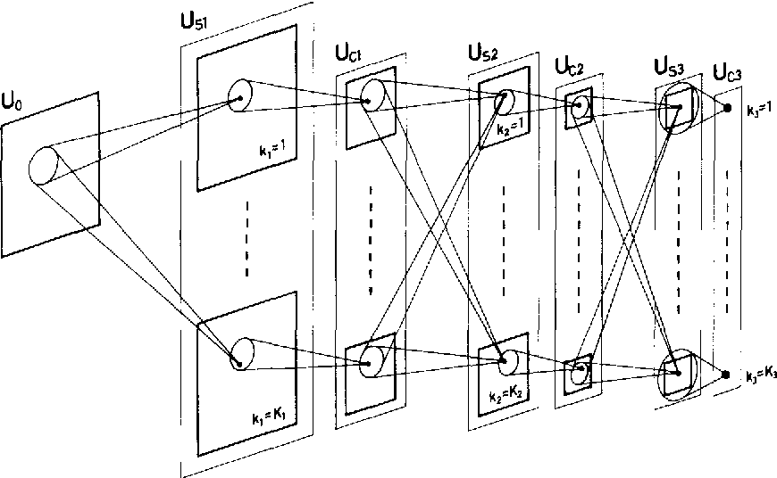
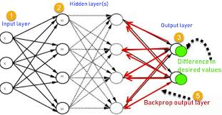
CNN History
Hubel and Wiesel : Visual cortex
Fukushima and Miyake : Neocognitron
LeCun : BP networks
Hinton : Deep learning

Slide 3
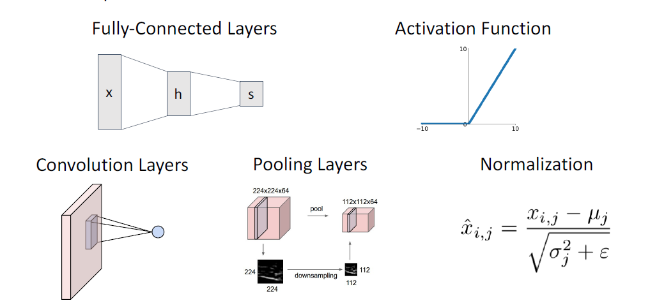
Components of a Convolutional Network

Slide 4
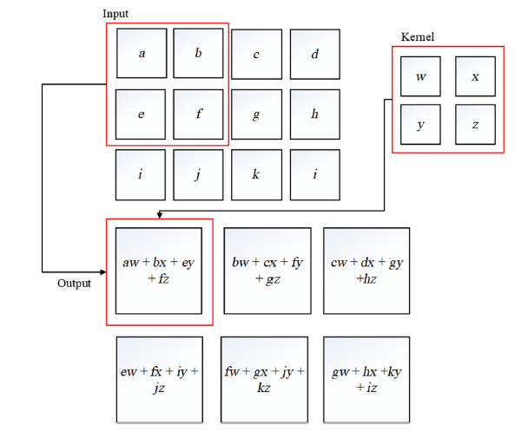
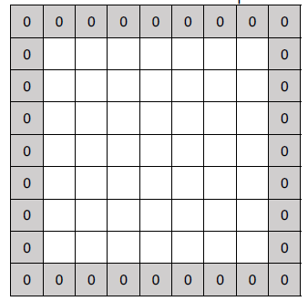
Convolution layer
Kernel
Sparse interactions
Weight sharing
Bias
Stride
Padding
Activation function
Stacking
High computational complexity

Slide 5
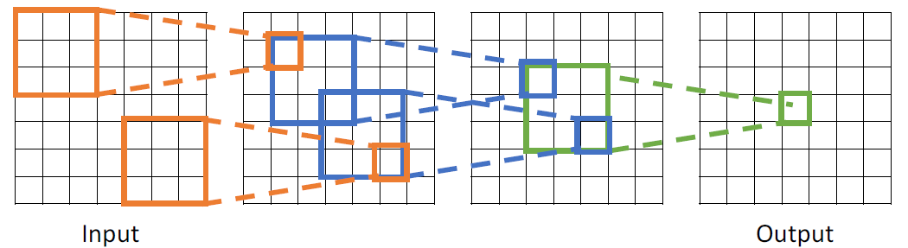
Receptive Fields:
Each successive convolution adds K – 1 to the receptive field size
With L layers the receptive field size is 1 + L * (K – 1)

Slide 6
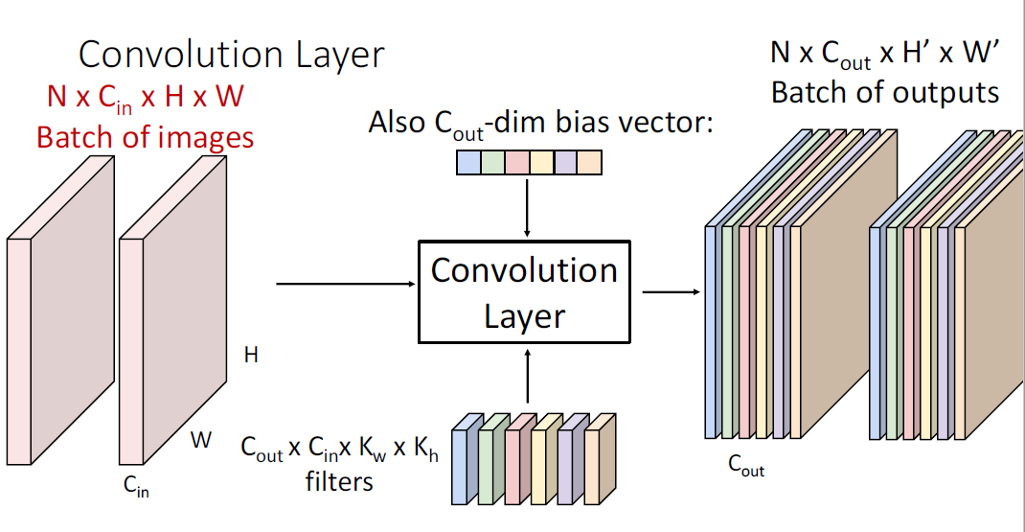
Convolution Summary
Common settings:
KH = KW (Small square filters)
P = (K – 1) / 2 (”Same” padding)
Cin, Cout = 32, 64, 128, 256 (powers of 2)
K = 3, P = 1, S = 1 (3x3 conv)
K = 5, P = 2, S = 1 (5x5 conv)
K = 1, P = 0, S = 1 (1x1 conv)
K = 3, P = 1, S = 2 (Downsample by 2)
Input: Cin x H x W
Hyperparameters:
- Kernel size: KH x KW
- Number filters: Cout
- Padding: P
- Stride: S
Weight matrix:
Cout x Cin x KH x KW
giving Cout filters of size
Cin x KH x KW
Bias vector: Cout
Output size: Cout x H’ x W’ where:
- H’ = (H – K + 2P) / S + 1
- W’ = (W – K + 2P) / S + 1

Slide 7
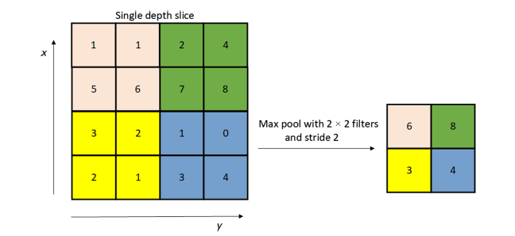
Pooling(Subsampling) Layers
Another way to downsample
Max Pooling
AVG Pooling
No learnable parameters
Low computational complexity
Common settings:
max, K = 2, S = 2
max, K = 3, S = 2 (AlexNet)
Input: C x H x W
Hyperparameters:
- Kernel size: K
- Stride: S
- Pooling function (max, avg)
Output: C x H’ x W’ where
- H’ = (H – K) / S + 1
- W’ = (W – K) / S + 1

Slide 8
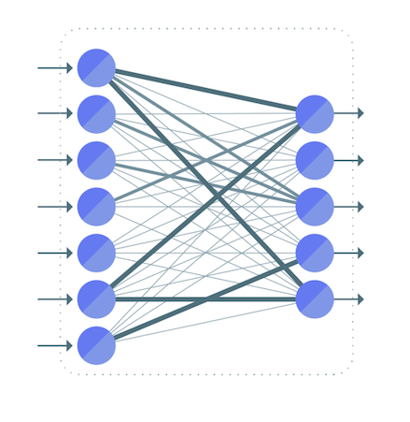
Fully connected layer
Flatten
Integrate local information
Most parameters
Softmax

Slide 9
LeNet

Slide 10
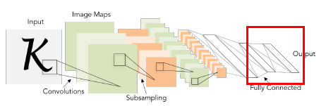
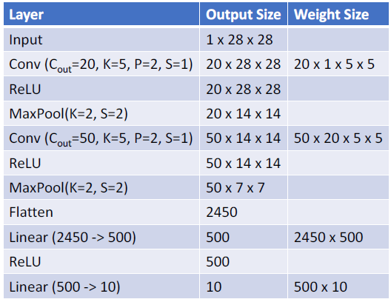
LeNet-5
Spatial size decreases
Number of channels increases
Total “volume” is preserved
Trial & error

Slide 11
AlexNet

Slide 12
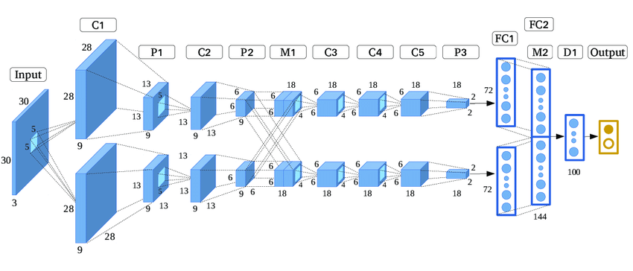
a)Dropout
Improvements of AlexNet network architecture Compared with LeNet-5:
ReLU activation function
Data augmentation
Dropout
Training on two NVIDIA GTX 580 3GB GPUs
Overlapping pooling
b)AlexNet Architecture

Slide 13
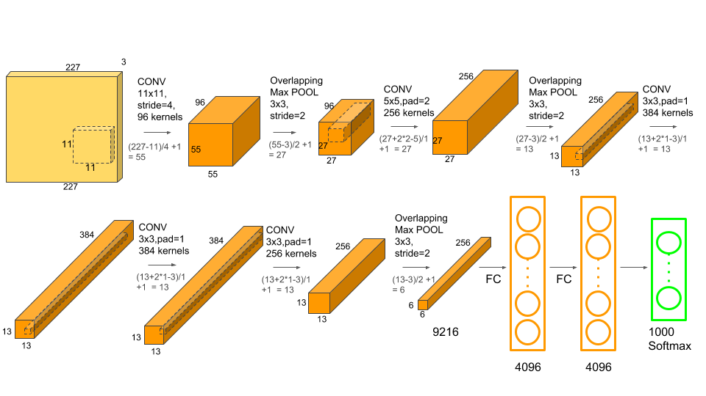
What Happens In AlexNet Architectuire?

Slide 14
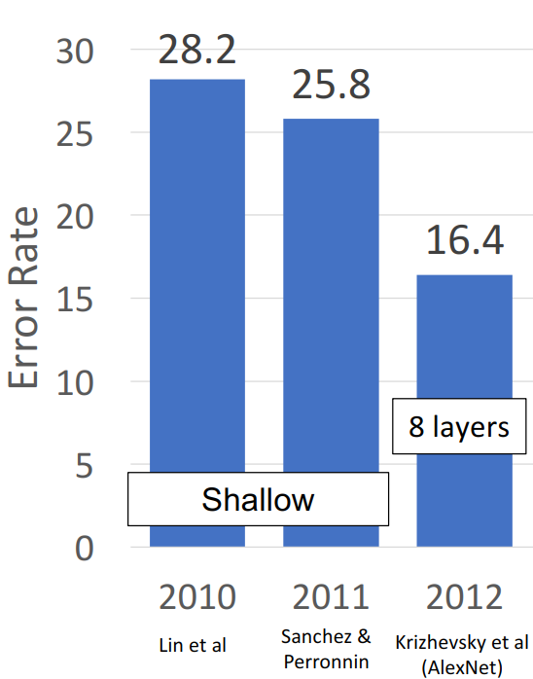
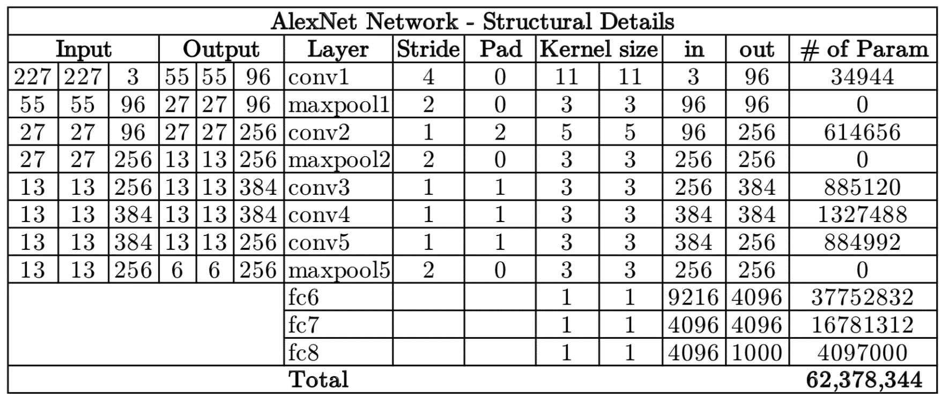
What About ImageNet Classification Challenge?
How Many Parameters Do We Have?

Slide 15
VGG-16/19

Slide 16
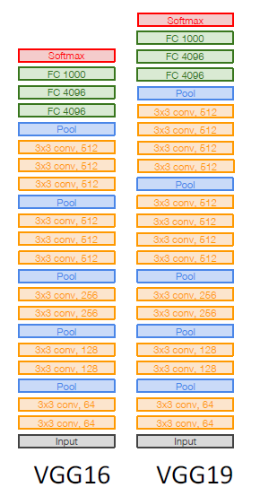
VGG: Deeper Networks, Regular Design
Shallow network limitations
Innovative design principles
All conv are 3x3 stride 1 pad 1
All max pool are 2x2 stride 2
After pool, double #channels
Consistent computational complexity
Network has 5 convolutional stages:
Stage 1: conv-conv-pool
Stage 2: conv-conv-pool
Stage 3: conv-conv-pool
Stage 4: conv-conv-conv-[conv]-pool
Stage 5: conv-conv-conv-[conv]-pool
(VGG-19 has 4 conv in stages 4 and 5)

Slide 17
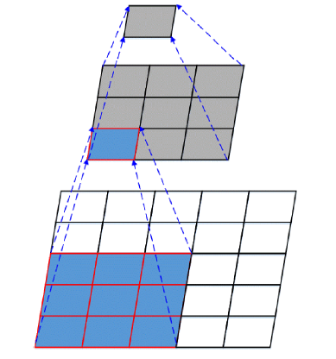
VGG (ctd): two Conv(3x3) vs one Conv(5x5)
Option 1:
Conv(5x5, C -> C)
Params: 25C2
FLOPs: 25C2HW
Option 2:
Conv(3x3, C -> C)
Conv(3x3, C -> C)
Params: 18C2
FLOPs: 18C2HW
More nonlinearity
Less params & FLOPS

Slide 18
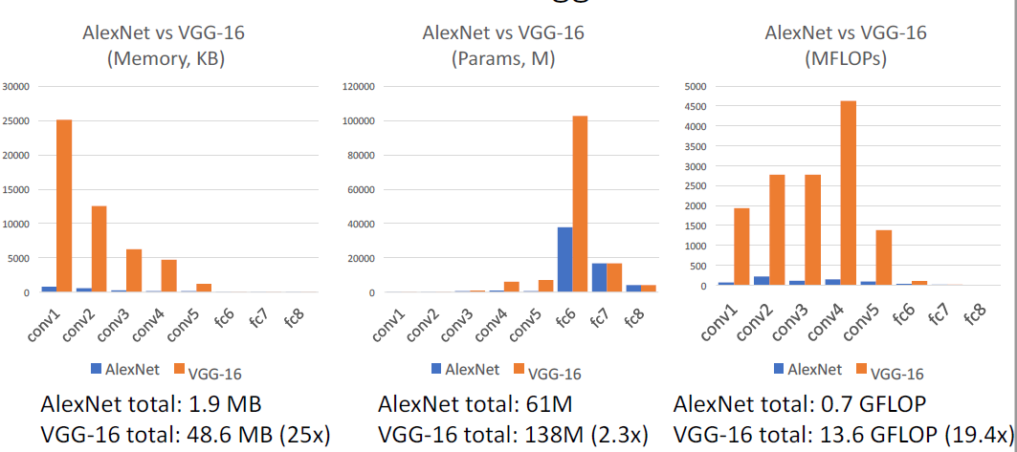
VGG (ctd):Consistent complexity computation
Input: C x 2H x 2W
Layer: Conv(3x3, C->C)
Memory: 4HWC
Params: 9C2
FLOPs: 36HWC2
Input: 2C x H x W
Conv(3x3, 2C -> 2C)
Memory: 2HWC
Params: 36C2
FLOPs: 36HWC2

Slide 19
GoogLeNet/Inception v1 to v3

Slide 20
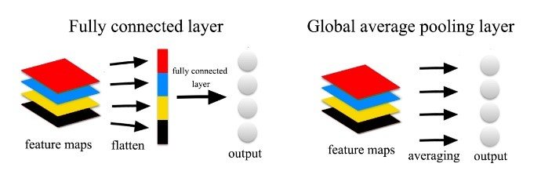
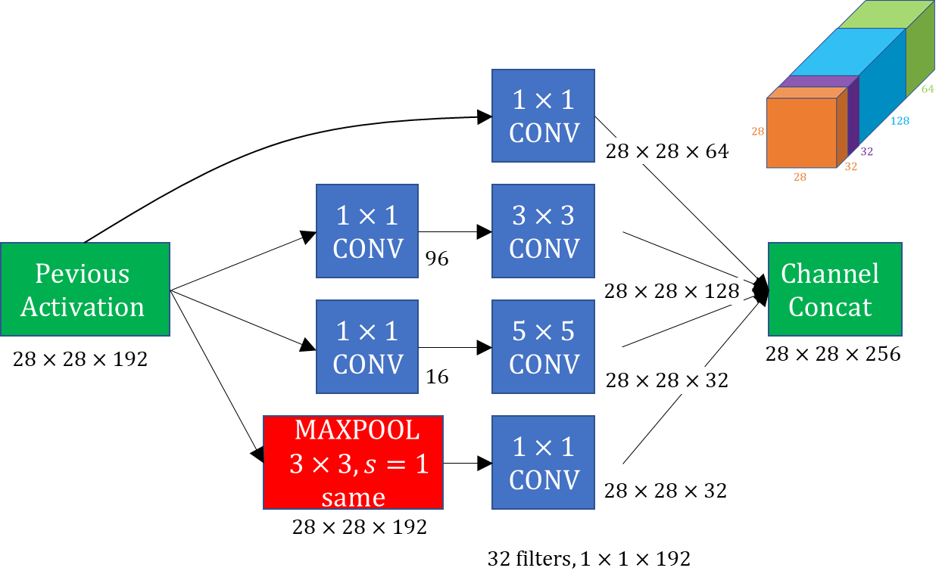
GoogLeNet Building Blocks:
1 × 1 convolution kernel
Change dimension of the feature map
Reduce number of parameters
Inception Module
Adaptive to different input shape
Global Avg Pooling
c) Global Avg Pooling
b) Inception Module V1
a) Conv 1*1

Slide 21
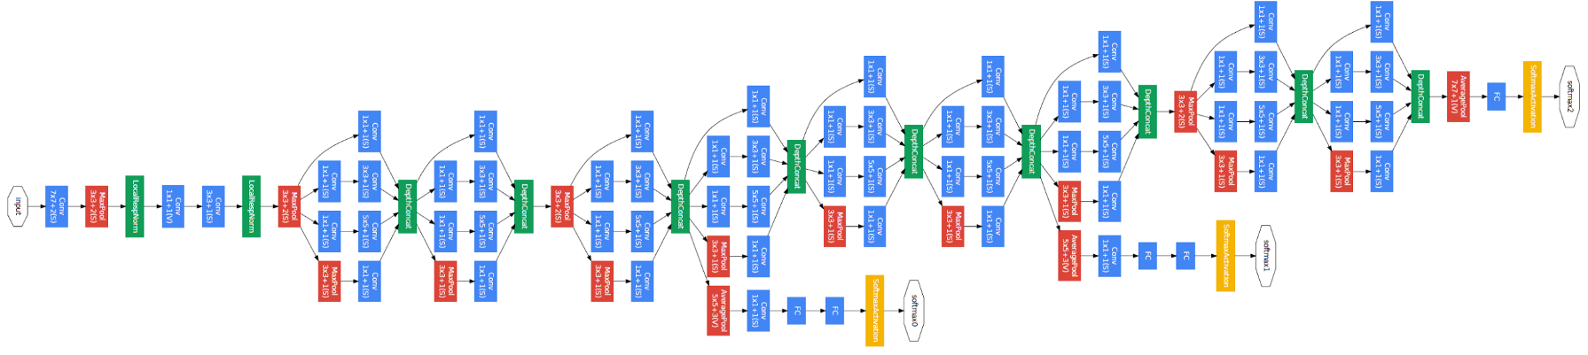
Main Idea:
Inspired by network in network
Focus on efficiency
What Are The Different Part Of The Network?
Global Avg Pooling
Aggressive Stem
Auxiliary Classifier
Inception Module
Auxiliary Classifier

Slide 22
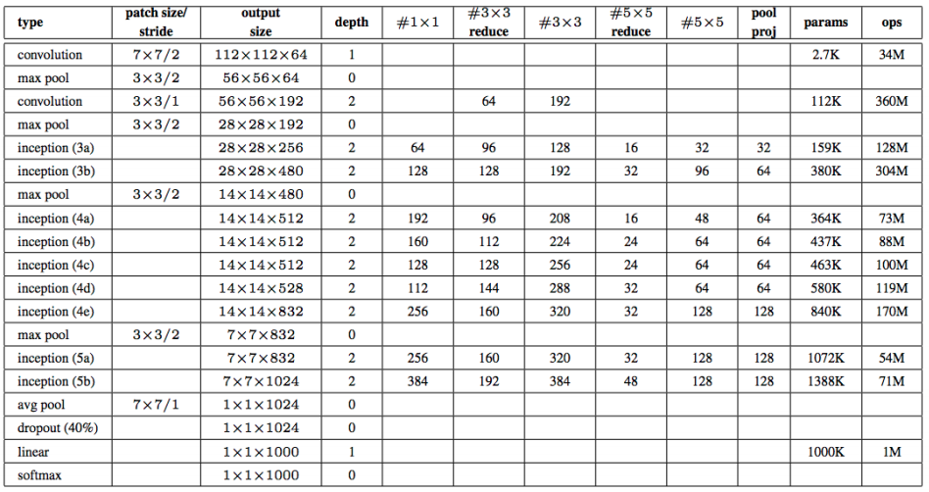
What happens inside GoogLeNet

Slide 23
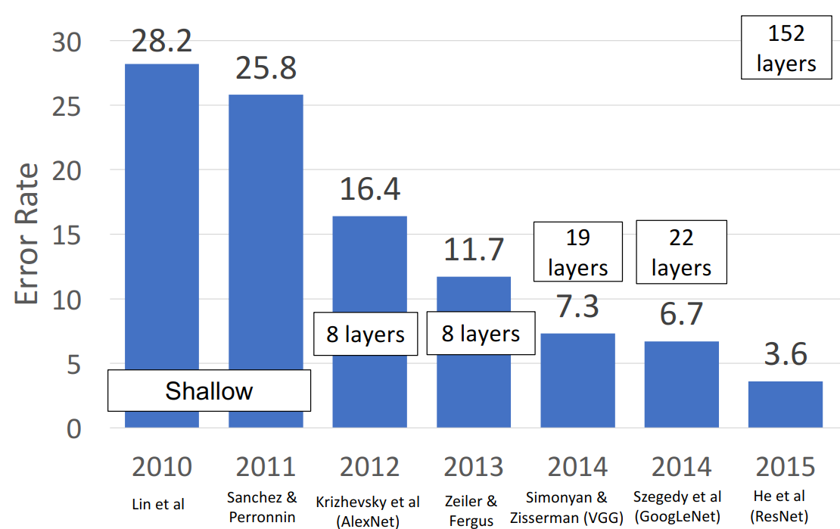
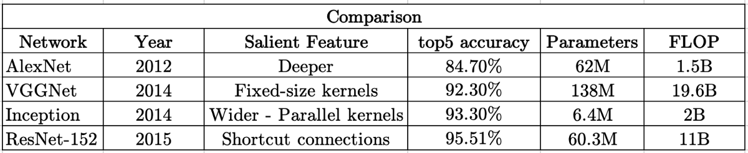
What About ImageNet Classification Challenge?
What happened compare to AlexNet?
Less parameters than AlexNet
More computation than AlexNet

Slide 24
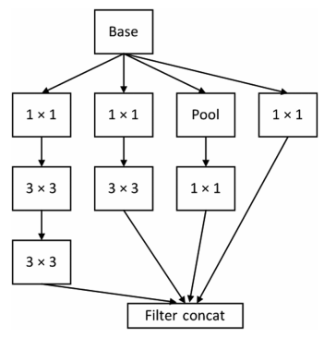
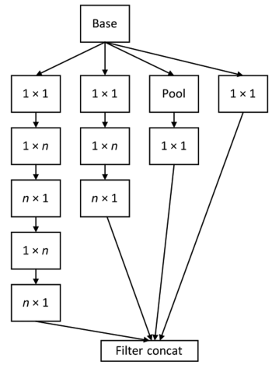
Inception Module V2
Batch Norm Layer Added
Faster convergence
Increase Robustness
Reduce usage of dropout
Replace Conv layer with kernel 5 × 5 by two 3 × 3 kernels
Increase network depth
9 layers increase compared to the last version
Reduce network parameter
Top 5 error: 4.9%
Inception Module V3
Spatial factorization into asymmetric convolutions
Change the network width from 224 × 224 to 299 × 299
Top 5 error: 3.58%

Slide 25
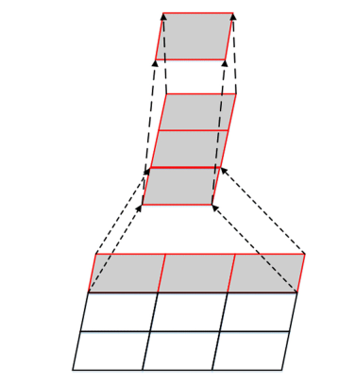
What is Spatial factorization into asymmetric convolutions?
Replace Conv layer with kernel n × n by 1 × n and n × 1 kernels
Reduce parameters
Reduce Computation cost

Slide 26
ResNet

Slide 27
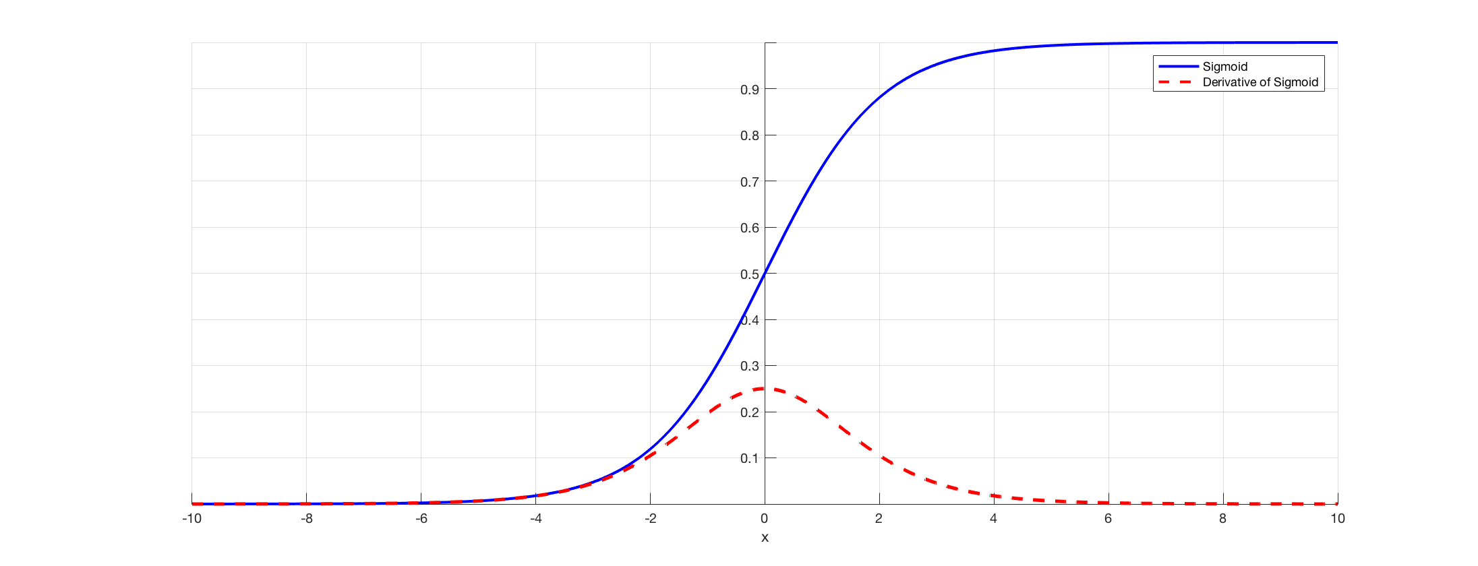
Vanishing gradient
problem
As more layers using certain activation functions are added to neural networks, the gradients of the loss function approaches zero, making the network hard to train
Reason
Certain activation functions, like the sigmoid function, squishes a large input space into a small input space between 0 and 1. Therefore, a large change in the input of the sigmoid function will cause a small change in the output. Hence, the derivative becomes small.
solutions
use other activation functions, such as ReLU.
batch normalization
Residual networks

Slide 28
Degradation problem
when the number of network layers increased, the accuracy of training set saturated or even decreased.
This cannot be interpreted as overfitting, as overfit should be better in the training set.
The degradation problem shows that deep networks cannot be optimized easily and well
ResNet proposed in order to solve the problems.

Slide 29
residual learning block
ResNet constructed by residual learning blocks
can break through a 100-layers barrier and even reach 1000 layers.
assuming the original function to be learned is H(x) the residual learning block is then converted to F(x)=H(x) – x
These two expressions have the same effect, but the difficulty of optimization is different
If an identity mapping was optimal, it would be easier to push the residual to zero than to fit an identity mapping by a stack of nonlinear layers.

Slide 30
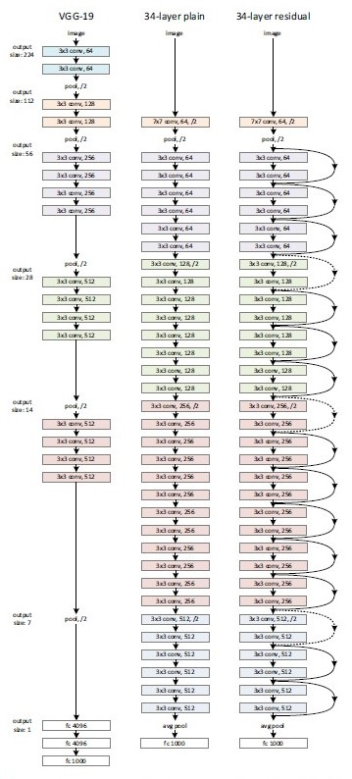
ResNet Network Architecture
plain network
The convolutional layers mostly have 3 × 3 filters
for the same output feature map size, the layers have the same number of filters
if the feature map size is halved, the number of filters is doubled so as to preserve the time complexity per layer.
downsampling preformed directly by convolutional layers that have a stride of 2
residual network
shortcut connections inserted which turn the network into residual network
The identity shortcuts can be directly used when the input and output are of the same dimensions
When the dimensions increase they are two options
The shortcut still performs identity mapping, with extra zero entries padded for increasing dimensions
The projection shortcut is used to match dimensions done by 1 × 1 convolutions

